Slide 1
Object Oriented Programming(Java) Lecture 11

Slide 2
Content
Java Interface.
implements Keyword in Interface.
Why use Interfaces?
extends Keyword in Interface.
Abstract Class vs Interface.

Slide 3
Java Interface :
An interface is a reference type in Java.
It is similar to class.
It is a collection of abstract methods.

Slide 4

Java Interface(Contd.) :
Here, Polygon is an interface. We have used the interface keyword to declare an interface.
abstract method getArea().

Slide 5
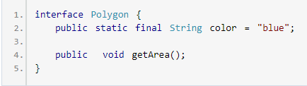
Java Interface(Contd.) :
In the above example, we have created an interface Polygon. It includes a constant variable color and an abstract method getArea().

Slide 6
implements Keyword in Interface :
Like abstract classes, we cannot create objects of interfaces.
However, we can implement interfaces in other classes.
In Java, we use the implements keyword to implement interfaces.

Slide 7
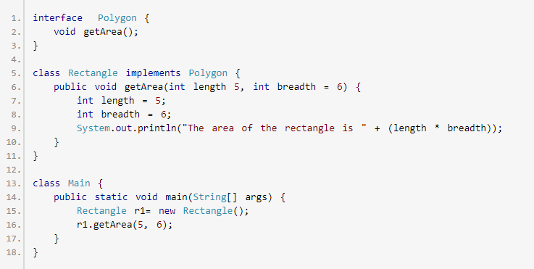
implements Keyword in Interface :

Slide 8
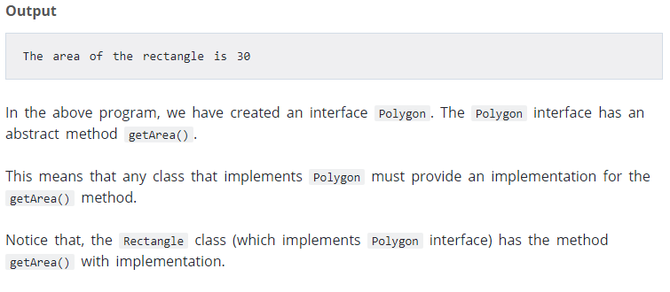
implements Keyword in Interface :

Slide 9
Why use Interfaces?
Interfaces provide specifications that a class (which implements it) must follow.
Interfaces are also used to achieve multiple inheritance in Java.
If a subclass is inherited from two or more classes, it's multiple inheritance.

Slide 10
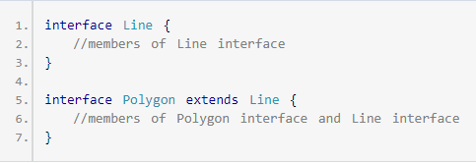
extends Keyword in Interface :
Similar to classes, interfaces can extend other interfaces.
The extends keyword is used for extending interfaces.

Slide 11
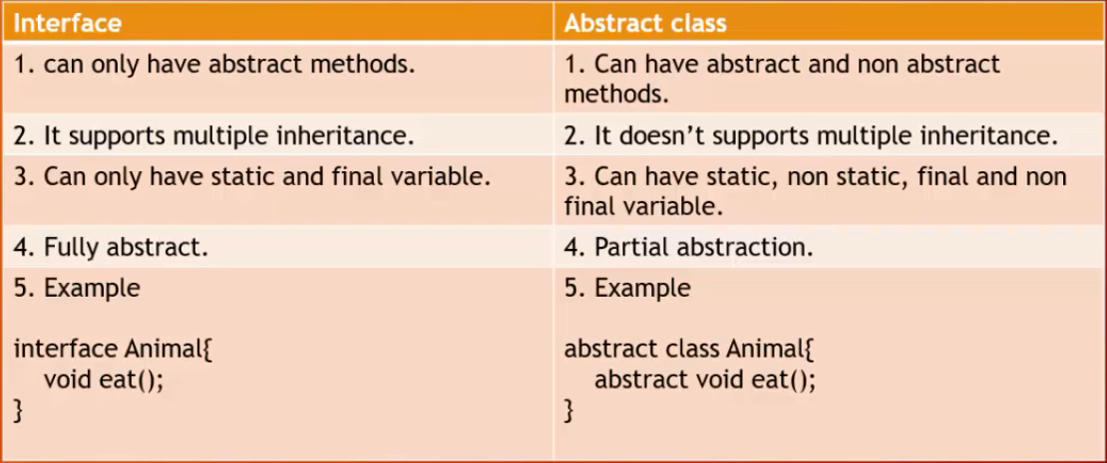
Abstract Class vs Interface :

Slide 12
References :
https://www.programiz.com/java-programming/interfaces.

Slide 13
Thanks

